Slide 1


Jenkins Pipeline
[ Adam ]
9739110917

Slide 2
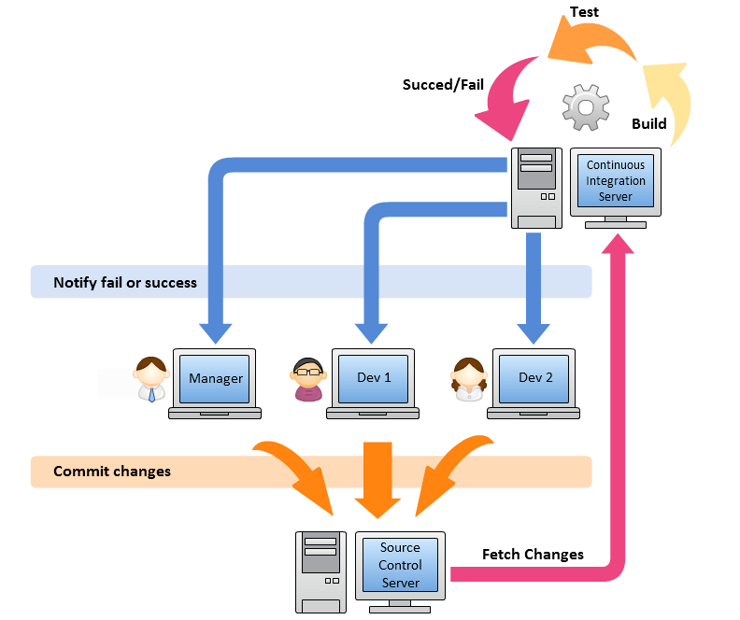
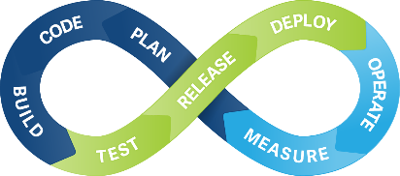
Continuous
Integration

Slide 3

Not every change is a release
Build software so that it can be rapidly & safely deployed to production by delivering every change to a production-like environment
Ensuring business applications and services function as expected through rigorous automated testing
Manual trigger of deployment when business is ready
Every change is proven to be deployable at any time
Continuous Delivery = Continuous Integration +
fully automated test suite

Slide 4







Continuous Integration
Build
UnitTest
Stage
Continuous Delivery
Build
UnitTest
Stage
Acceptance
Test
Deploy
Continuous Deployment
Build
UnitTest
Stage
Acceptance
Test
Deploy

Slide 5
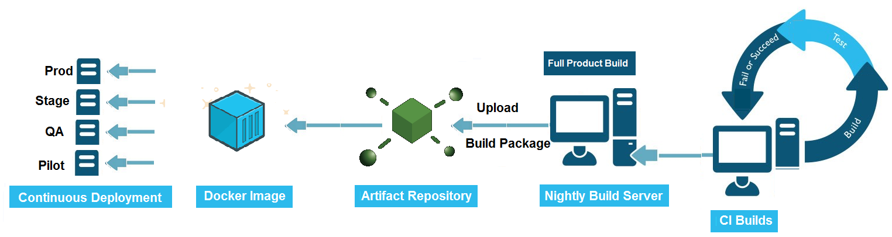
Continuous Delivery/Deployment Pipeline

Slide 6
What is Jenkins Pipeline?
Pipeline is a group of events or jobs which are interlinked with one another in a sequence.
Jenkins Pipeline is a combination of plugins that support the integration and implementation of continuous delivery pipelines using Jenkins
Pipeline provides an extensible set of tools for modeling simple-to-complex delivery pipelines "as code" via the Pipeline domain-specific language (DSL) syntax
Instead of building several jobs for each phase of the pipeline, you can now code the entire workflow as one script i.e ‘pipeline as code’

Slide 7
Why Jenkins Pipeline?
It models simple to complex pipelines as code by using Groovy DSL (Domain Specific Language)
The code is stored in a text file called the Jenkinsfile which can be checked into a SCM (Source Code Management)
Improves user interface by incorporating user input within the pipeline
It is durable in terms of unplanned restart of the Jenkins master
It can restart from saved checkpoints
It supports complex pipelines by incorporating conditional loops, fork or join operations and allowing tasks to be performed in parallel
It can integrate with several other plugins

Slide 8
What is a Jenkinsfile?
Jenkinsfile is a text file that stores the entire workflow as code and it can be checked into a SCM on your local system
This enables the developers to access, edit and check the code at all times
The Jenkinsfile is written using the Groovy DSL
Jenkinsfile can be created through a text/groovy editor or through the configuration page on the Jenkins instance
While the syntax for defining a Pipeline, either in the web UI or with a Jenkinsfile is the same, it is considered best practice to define the Pipeline in a Jenkinsfile and check that in to source control:
Automatically creates a Pipeline build process for all branches and pull requests.
Code review/iteration on the Pipeline
Single source of truth ^{[3]} for the Pipeline, which can be viewed and edited by multiple members of the project.

Slide 9
A Jenkinsfile can be written using two types of syntax - Declarative and Scripted
Scripted pipeline is a traditional way of writing the code.
uses stricter groovy based syntaxes
Jenkinsfile is written on the Jenkins UI instance
Declarative Pipeline is a more recent feature of Jenkins Pipeline which:
provides richer syntactical features over Scripted Pipeline syntax, and
is designed to make writing and reading Pipeline code easier

Slide 10
Pipeline Concepts
Pipeline:
This is a user defined block which contains all the processes such as build, test, deploy, etc.
It is a collection of all the stages in a Jenkinsfile. All the stages and steps are defined within this block.
It is the key block for a declarative pipeline syntax.
Syntax:
pipeline {
// DSL
}
Node/Agent:
A node is a machine that executes an entire workflow. It is a key part of the scripted pipeline syntax.
A agent is used on declarative pipeline syntax
Syntax:
pipeline {
agent { // DSL }
}

Slide 11
Stage:
The work is specified in the form of stages.
There must be at least one stage & can be more than one stage within this directive.
Each stage performs a specific task
Syntax:
pipeline {
stages {agent { //DSL }
stage (‘STAGENAME’) {
//DSL
}
}
}

Slide 12
Steps:
A step is nothing but a single task that executes a specific process at a defined time
These steps are carried out in sequence to execute a stage.
There must be at least one step within a steps
Syntax:
pipeline {
agent { //DSL }
stages {
stage (‘STAGENAME’) {
steps {
//DSL
}
}
}
}

Slide 13
Prerequisites
To use Jenkins Pipeline, you will need:
Jenkins 2.x or later (older versions back to 1.642.3 may work but are not recommended)
Pipeline plugin, which is installed as part of the "suggested plugins"

Slide 14
agent
The agent section specifies where the entire Pipeline, or a specific stage, will execute in the Jenkins environment depending on where the agent section is placed
The section can be defined at the top-level inside the pipeline block or at stage-level
Parameters:
Any: Execute the Pipeline, or stage, on any available agent
None: When applied at the top-level of the pipeline block no global agent will be allocated for the entire Pipeline run and each stage section will need to contain its own agent section
Label: Execute the Pipeline, or stage, on an agent available in the Jenkins environment with the provided label
Node: behaves the same as agent { label 'labelName' }, but node allows for additional options

Slide 15
Run pipeline stage on group of machines using label
pipeline {
agent any
stages {
stage('Stage1') {
steps {
echo 'First Stage'
}
}
}
}

Slide 16
Run 2 stages on group of machines
pipeline {
agent { label 'test' }
stages {
stage('Stage1') {
steps {
echo 'First Stage'
}
}
stage('Stage2') {
steps {
echo 'Second Stage'
}
}
}
}

Slide 17
Run Stage level agent section
pipeline {
agent none
stages {
stage('Stage1') {
agent { label 'test' }
steps {
echo 'First Stage'
}
}
stage('Stage2') {
agent any
steps {
echo 'Second Stage'
}
}
}
}

Slide 18
Custom Workspace for agent
pipeline {
agent none
stages {
stage('Stage1') {
agent {
node {
label 'test' // comment : use \\ for windows dir separator
customWorkspace 'D:\\CLASSROOM\\JENKINS\\workspace2'
}
}
steps {
echo 'First Stage'
}
}
stage('Stage2') {
agent any
steps {
echo 'Second Stage'
}
}
}
}

Slide 19
Directives: environment
An environment directive used in the top-level pipeline block will apply to all steps within the Pipeline
pipeline {
agent { label 'test' }
environment {
MYNAME = 'Adam'
}
stages {
stage('Stage1') {
steps {
bat "echo 'Your name: %MYNAME%'"
}
}
stage('Stage2') {
steps {
echo env.MYNAME
}
}
}
}

Slide 20
An environment directive defined within a stage will only apply the given environment variables to steps within the stage
pipeline {
agent { label 'test' }
environment {
VARVAL = 'global'
}
stages {
stage('Stage1') {
environment {
VARVAL = 'local'
}
steps {
bat "echo 'Your name: %VARVAL%'"
}
}
stage('Stage2') {
steps {
echo env.VARVAL
}
}
}
}

Slide 21
Directives: parameters
Provides a list of parameters which a user should provide when triggering the Pipeline. The values for these user-specified parameters are made available to Pipeline steps via the ‘params’ object
Available Parameters
String: A parameter of a string type
parameters { string(name: 'PERSON', defaultValue: 'Mr Adam', description: 'Who are you?') }
Text: A text parameter, which can contain multiple lines
parameters {text(name: 'BIOGRAPHY', defaultValue: “'', description: 'Enter info’) }
booleanParam: A boolean parameter
parameters {booleanParam(name: 'TOGGLE', defaultValue: true, description: 'Toggle this value')}
Choice: A choice parameter
parameters {choice(name: 'CHOICE', choices: ['One', 'Two', 'Three'], description: 'Pick something')}
File: A file parameter, which specifies a file to be submitted by the user when scheduling a build
parameters {file(name: "FILE", description: "Choose a file to upload")}

Slide 22
pipeline {
agent any
parameters {
string(name: 'PERSON', defaultValue: 'Mr Adam', description: 'Who are you?')
text(name: 'BIOGRAPHY', defaultValue: '', description: 'Enter some information about the person')
booleanParam(name: 'TOGGLE', defaultValue: true, description: 'Toggle this value')
choice(name: 'CHOICE', choices: ['One', 'Two', 'Three'], description: 'Pick something')
password(name: 'PASSWORD', defaultValue: 'SECRET', description: 'Enter a password')
file(name: "FILE", description: "Choose a file to upload")
}
stages {
stage('Example') {
steps {
echo "Hello ${params.PERSON}"
echo "Biography: ${params.BIOGRAPHY}"
echo "Toggle: ${params.TOGGLE}"
echo "Choice: ${params.CHOICE}"
echo "Password: ${params.PASSWORD}"
}
}
}
}

Slide 23
Directives: options
The options directive allows configuring Pipeline-specific options from within the Pipeline itself
Pipeline provides a number of these options:
buildDiscarder - Persist artifacts and console output for the specific number of recent Pipeline runs
pipeline {
agent { label 'test' }
options {
buildDiscarder(logRotator(numToKeepStr: '5'))
}
stages {
stage('Stage1') {
steps {
echo 'First Stage'
}
}
}
}

Slide 24
retry - On failure, retry the entire Pipeline the specified number of times
pipeline {
agent { label 'test' }
options {
retry(3)
}
stages {
stage('Stage1') {
steps {
bat 'waitfor test /t 10'
}
}
}
}

Slide 25
timeout - Set a timeout period for the Pipeline run, after which Jenkins should abort the Pipeline
pipeline {
agent { label 'test' }
options {
timeout(time: 5, unit: 'SECONDS')
}
stages {
stage('Stage1') {
steps {
bat 'waitfor test /t 25'
}
}
}
}

Slide 26
timestamps - Prepend all console output generated by the Pipeline run with the time at which the line was emitted
pipeline {
agent { label 'test' }
options {
timeout(time: 5, unit: 'SECONDS')
timestamps()
}
stages {
stage('Stage1') {
steps {
bat 'waitfor test /t 25'
}
}
}
}

Slide 27
disableConcurrentBuilds - By default, we will be able to trigger multiple builds i.e concurrent executions of the pipeline, we can disallow concurrent executions of the Pipeline. Can be useful for preventing simultaneous accesses to shared resources
pipeline {
agent { label 'test' }
options {
timestamps()
disableConcurrentBuilds()
}
stages {
stage('Stage1') {
steps {
bat 'waitfor test /t 25'
}
}
}
}

Slide 28
Directives: triggers
The triggers directive defines the automated ways in which the Pipeline should be re-triggered.
The triggers currently available are cron, pollSCM and upstream.
cron - Persist artifacts and console output for the specific number of recent Pipeline runs
pipeline {
agent { label 'test' }
triggers {
cron('* * * * *')
}
stages {
stage('Stage1') {
steps {
echo 'test'
}
}
}
}

Slide 29
pollSCM - Accepts a cron-style string to define a regular interval at which Jenkins should check for new source changes.
If new changes exist, the Pipeline will be re-triggered.
pipeline {
agent { label 'test' }
triggers {
pollSCM('* * * * *')
}
stages {
stage('Stage1') {
steps {
echo 'test'
}
}
}
}

Slide 30
upstream - Accepts a comma separated string of jobs and a threshold.
When any job in the string finishes with the minimum threshold, the Pipeline will be re-triggered
pipeline {
agent { label 'test' }
triggers {
upstream(upstreamProjects: 'job1', threshold: hudson.model.Result.SUCCESS)
}
stages {
stage('Stage1') {
steps {
echo 'test'
}
}
}
}

Slide 31
Directives: Steps
Basically, steps tell Jenkins what to do and serve as the basic building block
The steps section defines a series of one or more steps to be executed in a given stage directive
git - It performs a clone from the specified repository, shorthand for the generic SCM step
pipeline {
agent { label 'test' }
stages {
stage('Clone Repo') {
steps {
echo 'Going to Checkout from Git'
git branch: ‘master', url: 'https://github.com/scmlearningcentre/maven.git'
echo 'Completed Checkout from Git'
}
}
}
}

Slide 32
build - Triggers a new build for a given downstream job & waits for its completion
pipeline {
agent { label 'test' }
stages {
stage(‘Nightly') {
steps {
build 'Nightlyjob'
}
}
stage('Stage2') {
steps {
echo 'Testing'
}
}
}
}

Slide 33
build - Triggers a new build for a given downstream job & do not wait
pipeline {
agent { label 'test' }
stages {
stage(‘Build') {
steps {
build job: 'Nightlyjob', wait: false
}
}
stage('Stage2') {
steps {
echo 'Testing'
}
}
}
}

Slide 34
mail - Sending email
pipeline {
agent { label 'test' }
stages {
stage('mail') {
steps {
mail bcc: '', body: 'Hi Adam', cc: '', from: '', replyTo: '', subject: 'Test Mail', to: 'scmlearningcentre@gmail.com'
}
}
}
}

Slide 35
dir - Change current directory.
Any step inside the dir block will use this directory as current and any relative path will use it as base path
pipeline {
agent { label 'test' }
stages {
stage('Stage1') {
steps {
bat 'mkdir testfirst'
dir('D:\\CLASSROOM') {
bat 'mkdir test'
}
bat 'mkdir testlast'
}
}
}
}

Slide 36
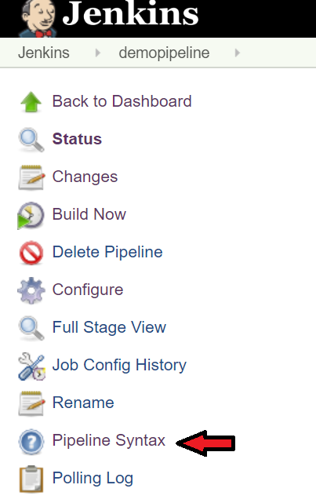
Properties - Refer to Pipeline syntax on the job options

Slide 37
input - allows you to prompt for input (If applied to a Step)
The step will pause after any options have been applied, and before running the tasks.
If the input is approved, the step will then continue.
Any parameters provided as part of the input submission will be available in the environment for the rest of the stage
CHECK PIPELINE SYNTAX

Slide 38
input - allows you to prompt for input (If Applied to a Stage)
The stage will pause after any options have been applied, and before running the tasks.
If the input is approved, the stage will then continue, any parameters provided as part of the input submission will be available in the environment for the rest of the stage
pipeline {
agent any
stages {
stage('Example') {
input {
message "Should we continue?"
ok "Yes, we should."
submitter “buildadmin"
parameters {
string(name: 'PERSON', defaultValue: 'Mr Jenkins', description: 'Who should I say hello to?')
}
}
steps {
echo "Hello, ${PERSON}, nice to meet you."
}
}
}
}

Slide 39
Directives: When
The when directive allows the Pipeline to determine whether the stage should be executed depending on the given condition. The when directive must contain at least one condition
Environment : Execute the stage when the specified environment variable is set to the given value
pipeline {
agent any
environment { DEPLOY_TO = 'qa'}
stages {
stage('Stage1') {
when {
environment name: 'DEPLOY_TO', value: 'qa'
}
steps {
echo 'Running Stage1 for QA'
}
}
stage('Stage2') {
when {
environment name: 'DEPLOY_TO', value: 'production'
}
steps {
echo 'Running Stage1 for production'
}
}
}
}

Slide 40
expression : Execute the stage when the specified Groovy expression evaluates to true, Note that when returning strings from your expressions they must be converted to booleans or return null to evaluate to false. Simply returning "0" or "false" will still evaluate to "true“
pipeline {
agent any
parameters {
booleanParam(name: 'TOGGLE', defaultValue: true, description: 'Toggle this value')
}
stages {
stage('Stage1') {
when {
expression { return params.TOGGLE }
}
steps {
echo 'Testing'
}
}
}
}

Slide 41
equals : Execute the stage when the expected value is equal to the actual value
pipeline {
agent any
parameters {
string(name: 'PERSON', defaultValue: 'Mr Adam', description: 'Who are you?')
}
stages {
stage('Stage1') {
when { equals expected: 'adam' , actual: params.PERSON }
steps {
echo 'Hi Adam !!'
}
}
}
}

Slide 42
Not equals : Execute the stage when the nested condition is false. Must contain one condition
pipeline {
agent any
parameters {
string(name: 'PERSON', defaultValue: 'Mr Adam', description: 'Who are you?')
}
stages {
stage('Stage1') {
when { not { equals expected: 'adam' , actual: params.PERSON }}
steps {
echo 'Hi Adam !!'
}
}
}
}

Slide 43
allOf : Execute the stage when all of the nested conditions are true. Must contain at least one condition
pipeline {
agent any
parameters {
string(name: 'PERSON', defaultValue: 'Mr Adam', description: 'Who are you?')
booleanParam(name: 'TOGGLE', defaultValue: true, description: 'Toggle this value')
}
stages {
stage('Stage1') {
when {
allOf {
equals expected: 'adam' , actual: params.PERSON
expression { return params.TOGGLE }
}
}
steps {
echo 'Hi Adam !!'
}
}
}
}

Slide 44
anyOf : Execute the stage when at least one of the nested conditions is true. Must contain at least one condition
pipeline {
agent any
parameters {
string(name: 'PERSON', defaultValue: 'Mr Adam', description: 'Who are you?')
booleanParam(name: 'TOGGLE', defaultValue: true, description: 'Toggle this value')
}
stages {
stage('Stage1') {
when {
anyOf {
equals expected: 'adam' , actual: params.PERSON
expression { return params.TOGGLE }
}
}
steps {
echo 'Hi Adam !!'
}
}
}
}

Slide 45
beforeagent : By default, the when condition for a stage will be evaluated after entering the agent for that stage, if one is defined.
If beforeAgent is set to true, the when condition will be evaluated first, and the agent will only be entered if the when condition evaluates to true
pipeline {
agent none
parameters {
string(name: 'PERSON', defaultValue: 'Mr Adam', description: 'Who are you?')
}
stages {
stage('Stage1') {
agent { label 'test' }
when {
beforeAgent true
equals expected: 'adam' , actual: params.PERSON
}
steps {
echo 'Hi Adam !!'
}
}
}
}

Slide 46
Parallel Stages
Stages in Declarative Pipeline by default run in sequential order
Stages in Declarative Pipeline may declare a number of nested stages within a parallel block
Note that a stage must have one and only one of steps, stages, or parallel
The nested stages cannot contain further parallel stages themselves
Any stage containing parallel cannot contain agent
Example: ** Create Empty dir D:\\CLASSROOM\\JENKINS\\para1 and D:\\CLASSROOM\\JENKINS\\para2 & current workspace

Slide 47
pipeline {
agent none
stages {
stage('In Sequential 1') {
agent { label 'test' }
steps {
echo "In Sequential 1"
git branch: 'master', url: 'https://github.com/scmlearningcentre/maven.git'
}
}
stage('In Sequential 2') {
agent {
node {
label 'test'
customWorkspace 'D:\\CLASSROOM\\JENKINS\\seq2'
}
}
steps {
echo "In Sequential 2"
git branch: 'master', url: 'https://github.com/scmlearningcentre/maven.git'
}
}
stage('Parallel In Sequential') {
parallel {
stage('In Parallel 1') {
agent {
node {
label 'test'
customWorkspace 'D:\\CLASSROOM\\JENKINS\\para1'
}
}
steps {
echo "In Parallel 1"
git branch: 'master', url: 'https://github.com/scmlearningcentre/maven.git'
}
}
stage('In Parallel 2') {
agent {
node {
label 'test'
customWorkspace 'D:\\CLASSROOM\\JENKINS\\para2'
}
}
steps {
echo "In Parallel 2"
git branch: 'master', url: 'https://github.com/scmlearningcentre/maven.git'
}
}
}
}
}
}

Slide 48
Post
The post section defines one or more additional steps that are run upon the completion of a Pipeline’s or stage’s run (depending on the location of the post section within the Pipeline)
Post can support any of the following post-condition blocks:
always: Steps are executed regardless of the completion status.
changed: Executes only if the completion results in a different status than the previous run.
fixed: Executes only if the completion is successful and the previous run failed
regression: Executes only if current execution fails, aborts or is unstable and the previous run was successful.
aborted: Steps are executed only if the pipeline or stage is aborted.
failure: Steps are executed only if the pipeline or stage fails.
success: Steps are executed only if the pipeline or stage succeeds.
unstable: Steps are executed only if the pipeline or stage is unstable.

Slide 49
pipeline {
agent any
stages {
stage('Example') {
steps { echo 'Hello Students' }
}
}
post {
always {
echo 'Hello again!'
}
}
}
Post step for a stage
pipeline {
agent any
stages {
stage('Stage1') {
steps { echo 'Stage 1' }
post {
always { echo 'Hello again!' }
}
}
stage('Stage2') {
steps { echo 'Stage 2' }
}
}
}

Slide 50
Handling failure:
pipeline {
agent any
stages {
stage('Example') {
steps { bat "exit 1" }
}
}
post {
failure {
mail body: 'Hi Adam', subject: 'The Pipeline failed', to: 'scmlearningcentre@gmail.com'
}
}
}

